Slide 1
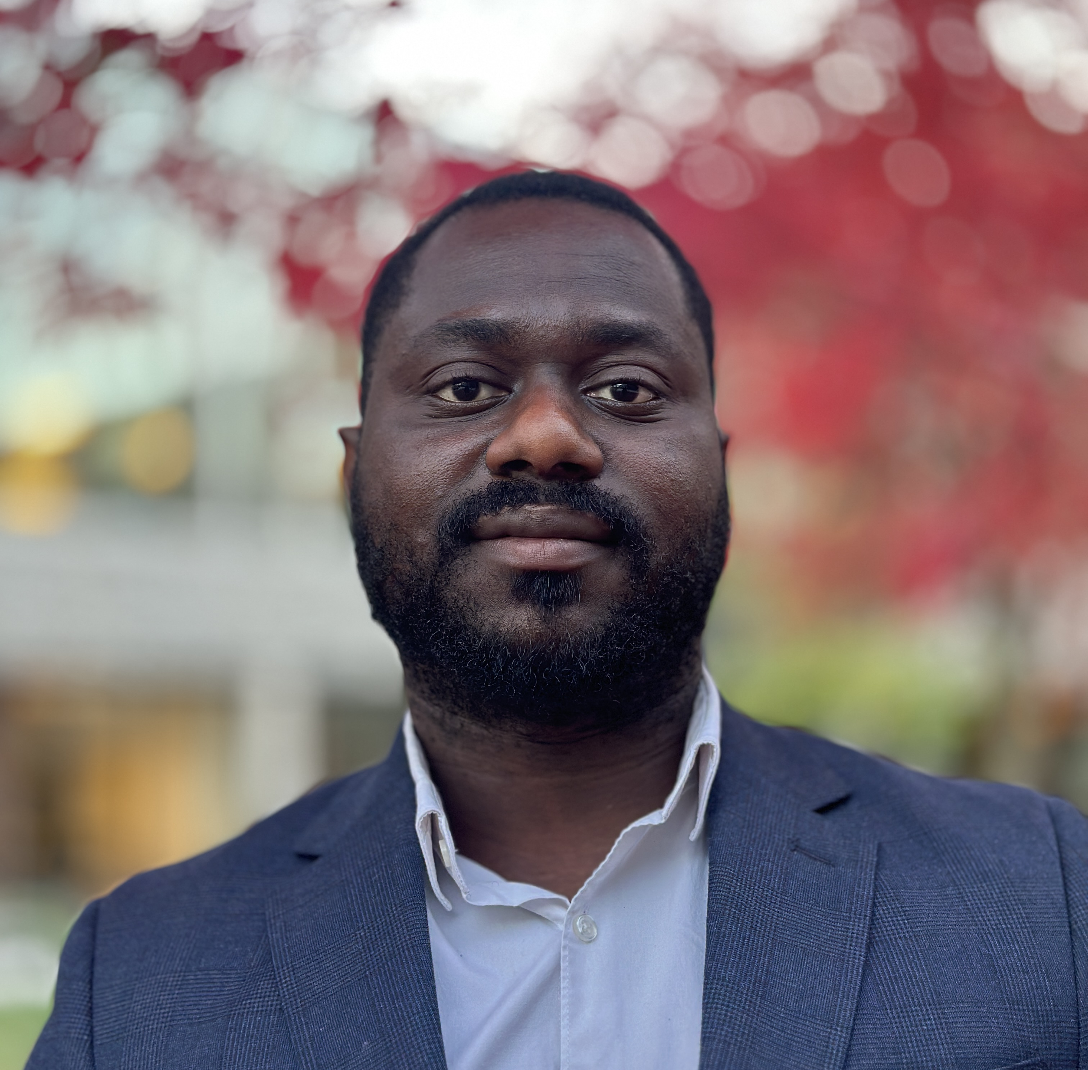
MARKETING PORTFOLIO
Daniel
Ebitunmise
Brand, Commercial & Experience Marketer
BRAND · COMMERCIAL · CREATORS · EVENTS · CUSTOMER
SELECTED WORK | 2016–2026
Notes:
[Sources]
- Career positioning: user-authored portfolio brief and supplied career materials.
- Portrait: user-provided IMG_9301.jpg, supplied 2026-09-03.
[/Sources]

Slide 2
ABOUT
I’ve built my career across brands and experiences.
I’m a senior marketer with experience at Coca-Cola and Rogers, an agency foundation and an entrepreneurial track record through TPC. My work spans brand management, commercial planning, creator partnerships, retention and event production.
01
02
03
04
05
COCA-COLA
AGENCY
ROGERS
TPC
CONSULTING
WHAT YOU’LL SEE
Work Experience: Coca-Cola, agency and Rogers · Entrepreneurial Projects: TPC · Consulting Projects: selected client work
The portfolio is organized around those three sections.
DANIEL EBITUNMISE / MARKETING PORTFOLIO
02
Notes:
[Sources]
- Personal summary and portfolio structure: user-authored brief and feedback, 2026-09-03.
[/Sources]

Slide 3
SECTION 01
WORK EXPERIENCE
01
01
2018 FIFA World Cup
Creator partnerships across six markets
02
Schweppes relaunch
2016–2024
AGENCY · COCA-COLA · ROGERS
Mixology, creators and live brand experiences
03
5Alive brand management
Portfolio, innovation, campaigns and P&L
The following slides focus on the work I delivered inside established organizations.
04
Commercial and retail
Brand plans translated into market execution
05
Agency and Rogers
Agency foundation and customer retention
DANIEL EBITUNMISE / MARKETING PORTFOLIO
03
Notes:
[Sources]
- Section structure and project selection: user-authored portfolio brief and feedback, 2026-09-03.
[/Sources]

Slide 4
WORK EXPERIENCE · THE COCA-COLA COMPANY
My Coca-Cola experience
+25%
26%
+5 pts
FIFA PROGRAM
COST SAVINGS
SCHWEPPES
BRAND LOVE
ENGAGEMENT VS. PRIOR PLAYBOOK
6
10
50+
$300K+
markets in the FIFA World Cup 2018 program
celebrity partners over nine months
sponsorships across music, sport and campus
earned media value across sponsorship programs
Metrics shown span multiple creator, Schweppes and sponsorship programs.
DANIEL EBITUNMISE / MARKETING PORTFOLIO
04
Notes:
[Sources]
- FIFA results: Daniel O. Ebitunmise 23.07.25-2.docx
- Schweppes, sponsorship and playbook results: Daniel Ebitunmise Resume 13062026.pdf
[/Sources]

Slide 5
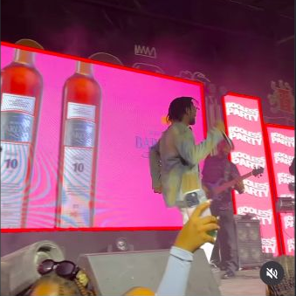
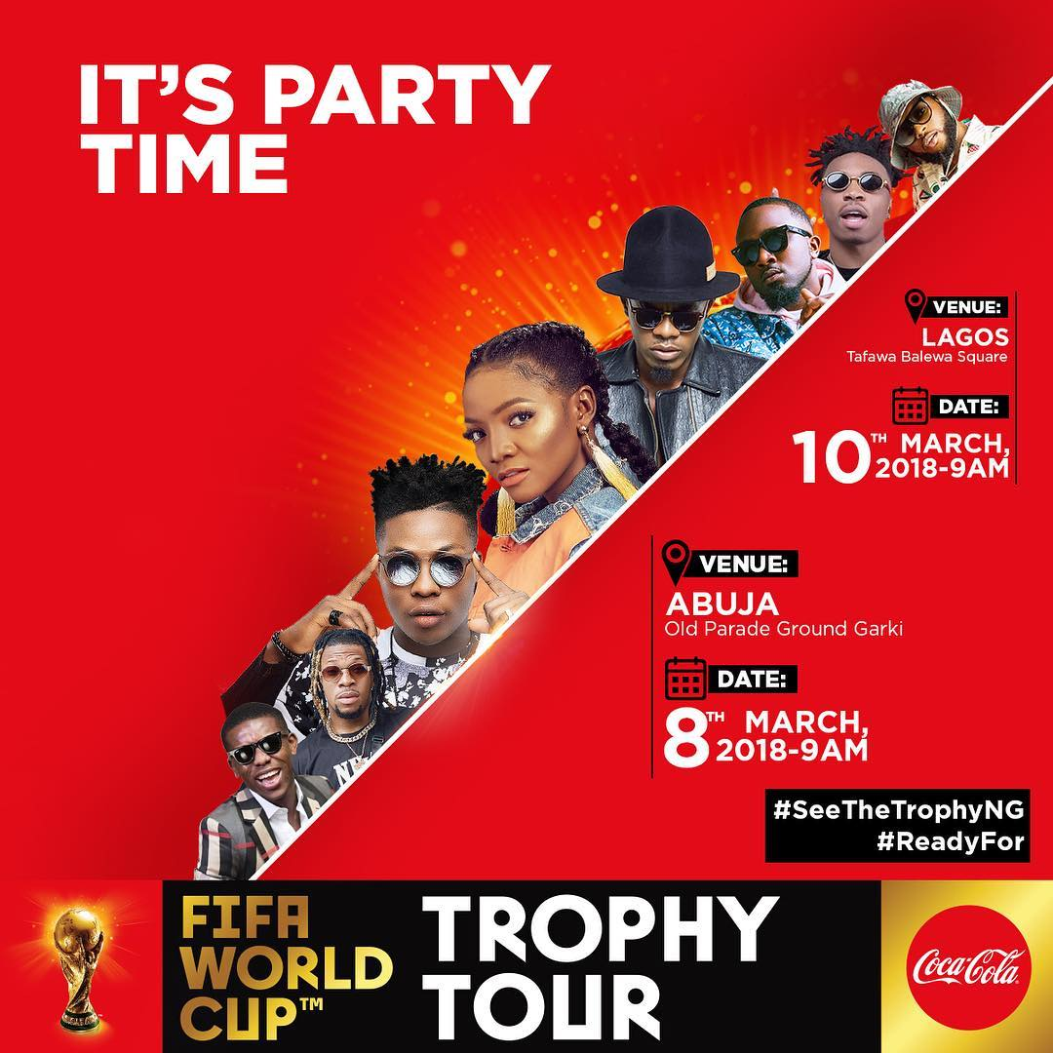
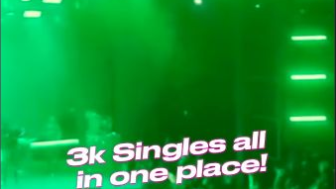
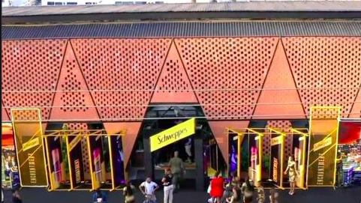
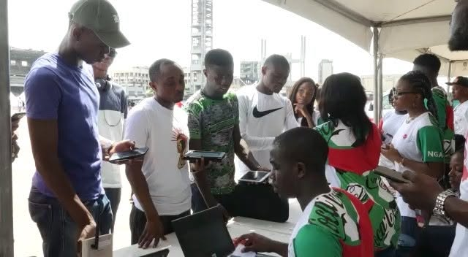
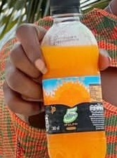


COCA-COLA · 2018 FIFA WORLD CUP
I led the creator program across six markets.
THE BRIEF
Make the global FIFA sponsorship feel locally relevant across six West African markets while managing talent costs, rights and content quality.
MY ROLE
Creator partnerships and program management across talent, contracts, content calendars and local fan moments.
WHAT I DID
Sourced and negotiated with 10 celebrity partners over nine months, then connected their content to the FIFA Trophy Tour and other fan experiences.
6 markets · 10 partners · 26% cost savings · click images
DANIEL EBITUNMISE / MARKETING PORTFOLIO
05
Notes:
[Sources]
- FIFA program scope and results: career materials cited in the source portfolio.
- Campaign visual: https://www.instagram.com/p/BgB_MOFnmr3/
- Trophy Tour recap: https://www.instagram.com/p/BgW-C00HknG/
- Additional World Cup campaign post: https://www.instagram.com/p/BgHDXD4nR1Y/
- Coca-Cola logo: https://commons.wikimedia.org/wiki/File:Coca-Cola_logo.svg
[/Sources]

Slide 6
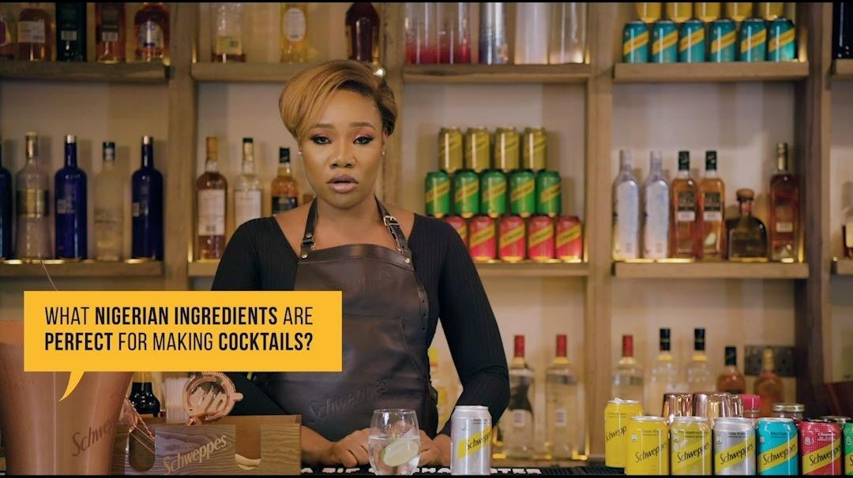
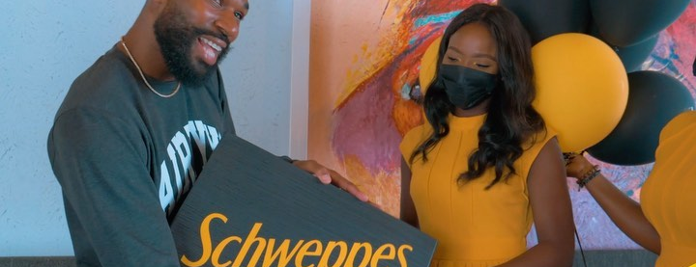
COCA-COLA · SCHWEPPES RELAUNCH
My work on the Schweppes relaunch
THE BRIEF
Reintroduce Schweppes as the premium mixer in the portfolio and give people more reasons to choose it in venues and at home.
MY ROLE
Brand experience, creator partnerships and launch activation.
WHAT I DID
Built the story around cocktail occasions, produced a mixology series, activated lounges and recruited creators to attend, capture and extend the experience online.
mixology · launch event · lounges · creator content · click images
DANIEL EBITUNMISE / MARKETING PORTFOLIO
06
Notes:
[Sources]
- Schweppes relaunch strategy and role: user-authored voice transcript, 2026-09-03.
- Launch experience: https://www.instagram.com/tv/CWidyMYjcYi/
- Mixology series: https://www.instagram.com/p/CIbFRrAKOvQ/
- Creator content: https://www.instagram.com/p/CRMXO0Alkxt/
[/Sources]

Slide 7
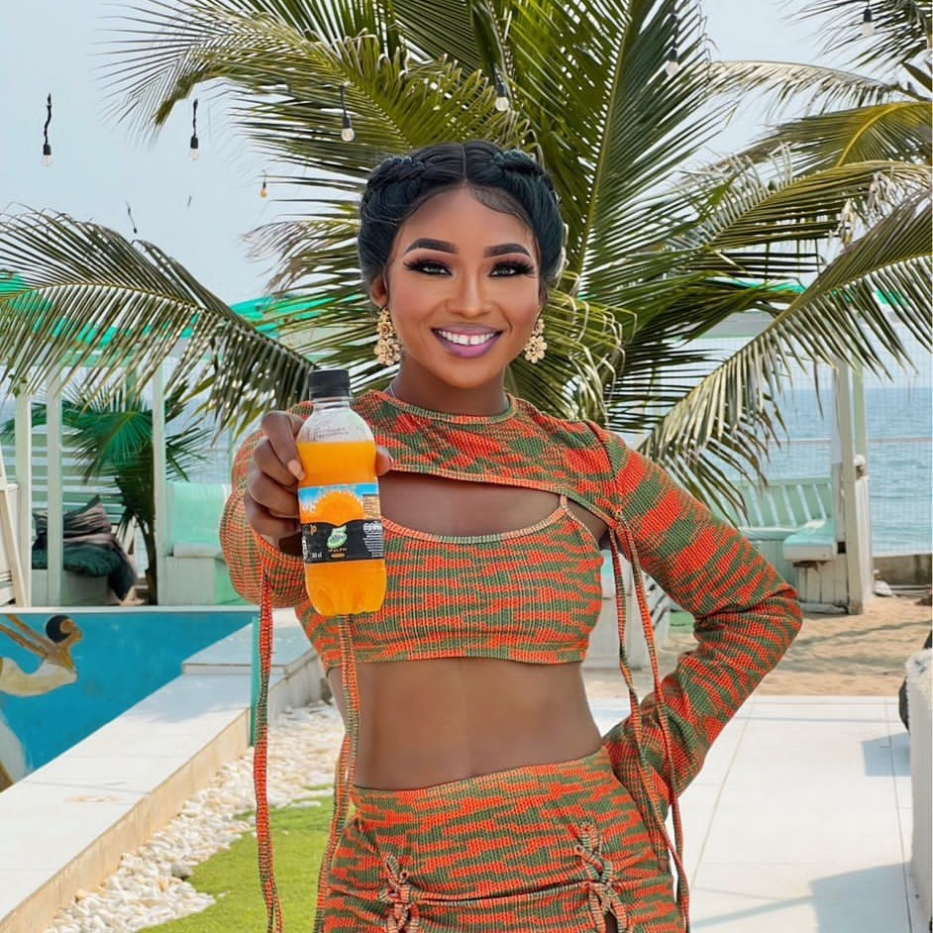
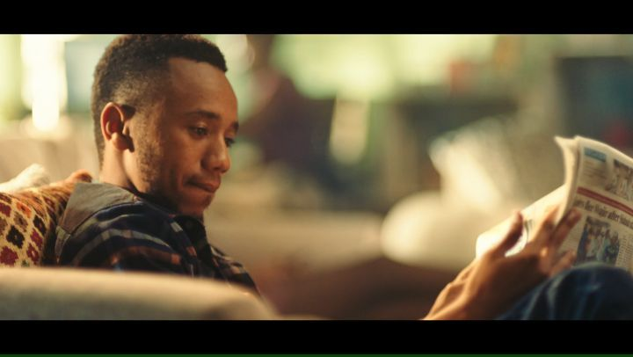
COCA-COLA · 5ALIVE BRAND MANAGEMENT
My 5Alive brand management work
THE BRIEF
Grow a $20M juice portfolio, improve margin and give consumers more reasons to choose the brand across occasions and channels.
MY ROLE
Brand management, portfolio strategy and P&L ownership.
WHAT I DID
Managed the portfolio roadmap and P&L, launched two SKUs, developed the TVC and creator brief, and aligned sales and marketing around launch and retail execution.
$20M P&L · 2 launches · TVC · creators · retail · click images
DANIEL EBITUNMISE / MARKETING PORTFOLIO
07
Notes:
[Sources]
- Portfolio scope and outcomes: career materials cited in the source portfolio.
- Role detail including two launches, TVC, creator briefing and commercial alignment: user-authored voice transcript, 2026-09-03.
- Creator campaign: https://www.instagram.com/p/Cmb9gPpshzx/
- Launch post: https://www.instagram.com/p/CdIXKBAlhij/
- Creator reel: https://www.instagram.com/reel/Cmj0NUNJtzb/
[/Sources]

Slide 8
COCA-COLA · COMMERCIAL & RETAIL RESULTS
I translated brand plans into commercial and retail execution.
$20M
+17% sales
+23%
engagement
JUICE PORTFOLIO P&L
+5% margin
2 SKUs launched
MARKETING OPERATIONS RESULTS
+10%
+5%
+2.5%
forecast accuracy
revenue growth YoY
volume growth YoY
Results span Brand Manager and Marketing Operations roles at The Coca-Cola Company.
DANIEL EBITUNMISE / MARKETING PORTFOLIO
08
Notes:
[Sources]
- All outcomes: Daniel Ebitunmise Resume 13062026.pdf
[/Sources]

Slide 9
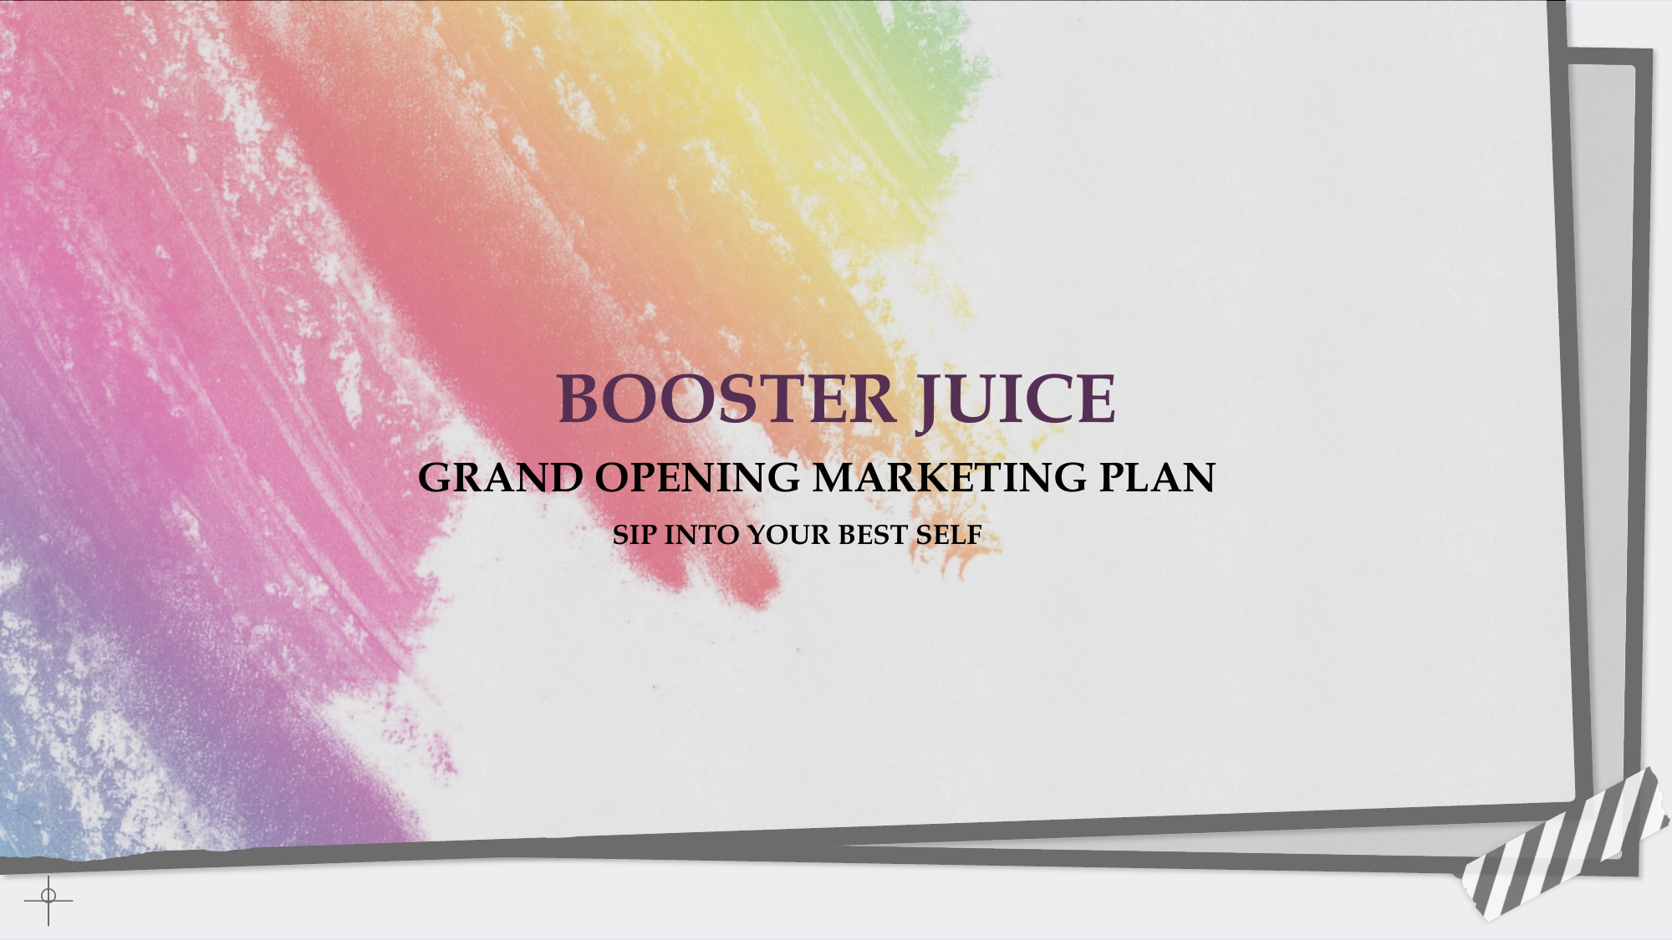
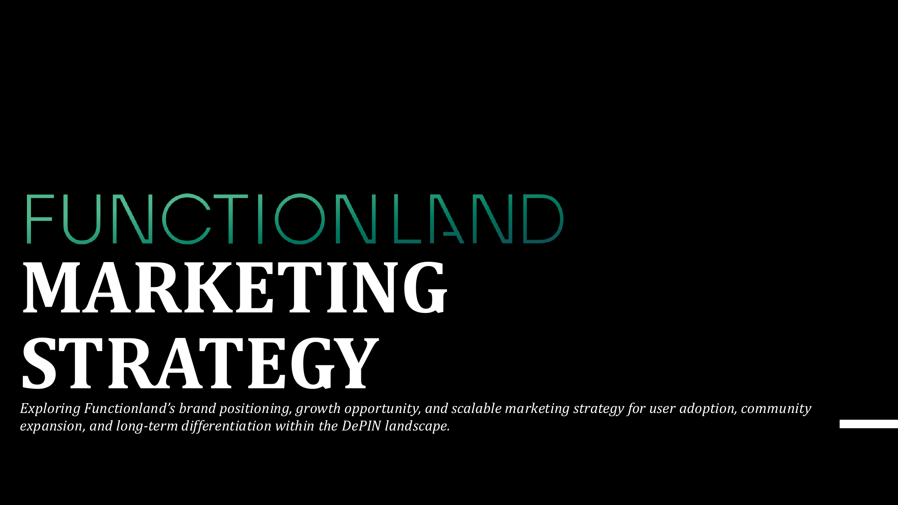
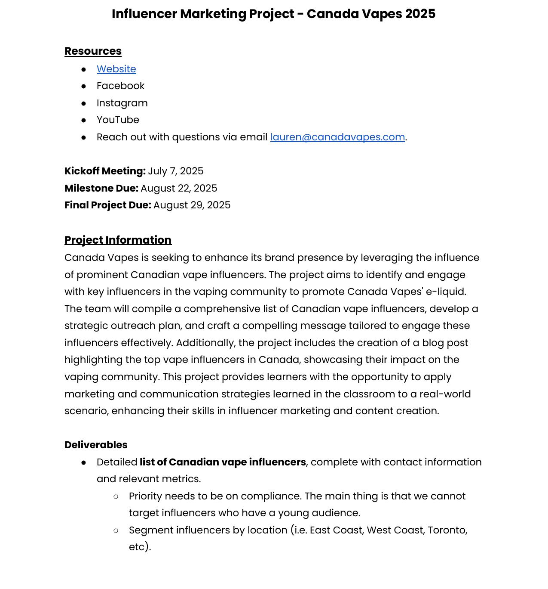
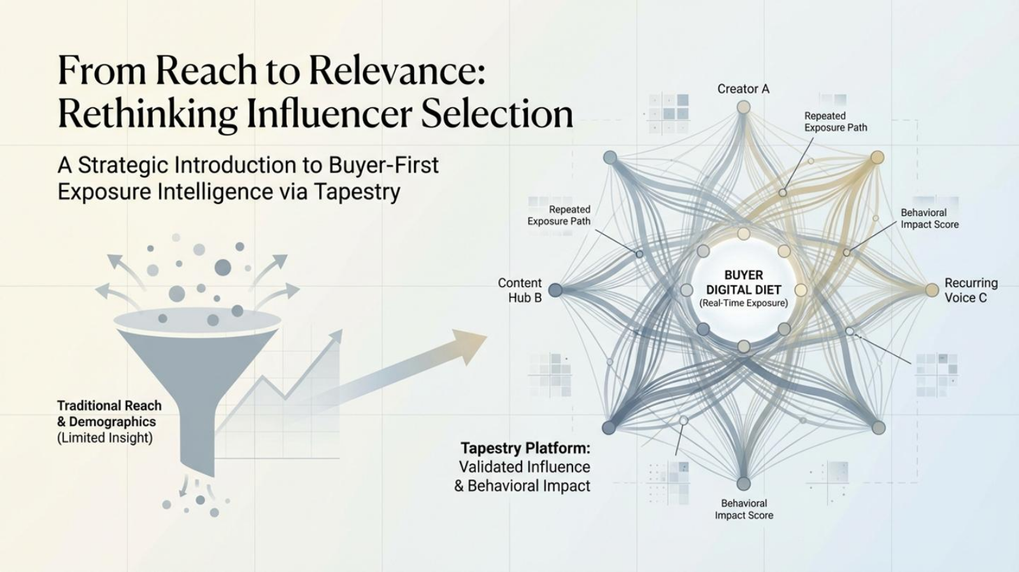



WORK EXPERIENCE · AGENCY · 2016–2018
I built my marketing foundation on the agency side.
DIGITAL & SOCIAL
PR & REPUTATION
Digital strategy, channel plans and day-to-day campaign execution.
Press releases, media monitoring, sentiment tracking and issues response.
CAMPAIGN MANAGEMENT
Briefs, teams, timelines, reporting and optimization.
CREATORS & PARTNERS
Influencer strategy, partner coordination and delivery.
SELECT CLIENT EXPERIENCE
British American Tobacco · Philip Morris International · P&G · Diageo · Coca-Cola
DANIEL EBITUNMISE / MARKETING PORTFOLIO
09
Notes:
[Sources]
- Agency dates, client experience and responsibilities: user-authored voice transcript, 2026-09-03, and career materials cited in the source portfolio.
- Google logo: https://commons.wikimedia.org/wiki/File:Google_2015_logo.svg
- British Airways logo: https://commons.wikimedia.org/wiki/File:BRITISH_AIRWAYS_logo.svg
- Unilever logo: https://commons.wikimedia.org/wiki/File:Unilever_text_logo.svg
- Nokia logo: https://commons.wikimedia.org/wiki/File:Nokia_2023.svg
[/Sources]

Slide 10
WORK EXPERIENCE · ROGERS BANK
At Rogers Bank, I focused on customer retention.
I used customer and service data to focus retention activity, support frontline teams and improve the save experience. The work reduced churn 5% within six months, maintained 98% CSAT and improved service efficiency 15%.
01
02
03
04
05
SIGNAL
PRIORITIZE
PERSONALIZE
ENABLE
LEARN
Find churn, complaint and service patterns
Focus outreach where intervention can matter
Adapt the conversation to the customer
Improve workflow and team capability
Feed outcomes back into the process
MY ROLE: analytics-led prioritization, frontline enablement and customer-experience improvement.
DANIEL EBITUNMISE / MARKETING PORTFOLIO
10
Notes:
[Sources]
- Rogers Bank role, method and outcomes: career materials cited in the source portfolio.
- Verified outcomes retained from the source deck: 5% churn reduction within six months, 98% CSAT and 15% service-efficiency improvement.
[/Sources]

Slide 11
SECTION 02
ENTREPRENEURIAL PROJECTS
TPC
01
TPC platform
My role across marketing, partnerships and operations
02
Fire & Sand
COMMUNITY-LED
LIVE EXPERIENCES
Beach, bonfire and rave experience
03
Booless Party
Singles event with live celebrity performances
The following slides show how we built, marketed and operated recurring event properties.
04
Balloons & Cups
Summer pool-party format and original campaign
05
Growth and sponsorships
Community, partners, content and live delivery
DANIEL EBITUNMISE / MARKETING PORTFOLIO
11
Notes:
[Sources]
- TPC section structure and role summary: user voice transcript and supplied Instagram links, 2026-09-03.
[/Sources]

Slide 12

ENTREPRENEURIAL PROJECTS · TPC
My work building the TPC event portfolio
THE IDEA
Create recurring event properties that people would anticipate and that sponsors could join in a credible way.
MY ROLE
Marketing lead, partnership and sponsorship lead, creative co-director and live-operations lead.
WHAT I DID
Shaped each event’s positioning, sold sponsorships, co-created campaigns and managed live delivery across Booless Party, Balloons & Cups and Fire & Sand.
3 event properties · marketing · sponsors · creative · live ops
DANIEL EBITUNMISE / MARKETING PORTFOLIO
12
Notes:
[Sources]
- Role ownership and event-property context: user-authored voice transcripts, 2026-09-02 and 2026-09-03.
- Booless event capture: https://www.instagram.com/reel/C3NatAhss3G/
- Booless pre-event promotion: https://www.instagram.com/reel/C2rRQnSIbaa/
- Coca-Cola sponsor content: https://www.instagram.com/reel/ComnYwNqgPG/
[/Sources]

Slide 13
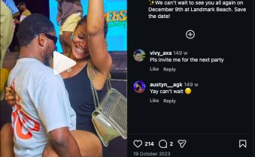
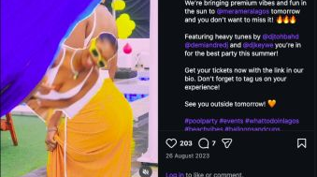
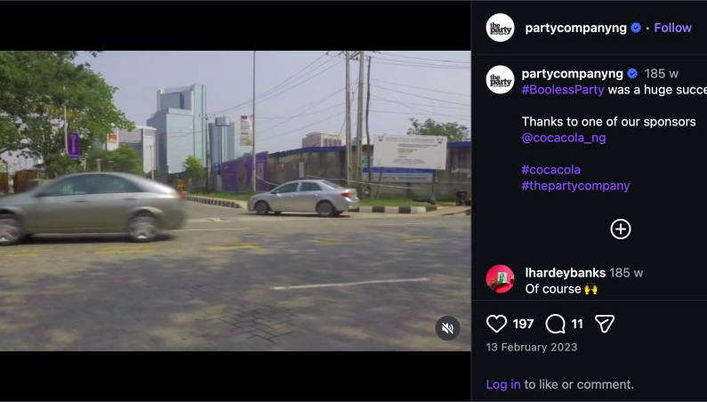
ENTREPRENEURIAL PROJECTS · TPC EVENT PORTFOLIO
Each TPC event had a distinct audience promise.
FIRE & SAND
BALLOONS & CUPS
Beach, bonfire and rave property built on repeat community attendance.
Role: marketing, sponsors and live operations.
Summer pool-party format built around an original campaign.
Role: story, casting and creative direction.
THE OPERATING MODEL
Community growth, sponsor value, content and live delivery were planned together. This made each format easier to repeat.
BOOLESS PARTY
Annual singles event with live celebrity performances.
Role: positioning, sponsor sales, creative and delivery.
MY ROLE ACROSS THE PORTFOLIO
marketing · sponsor sales · creative co-direction · content · live operations
DANIEL EBITUNMISE / MARKETING PORTFOLIO
13
Notes:
[Sources]
- Property definitions and Daniel's role across each: user-authored voice transcript, 2026-09-03.
- Fire & Sand: https://www.instagram.com/reel/CylraUfsIJl/
- Booless Party: https://www.instagram.com/reel/C3NatAhss3G/
- Balloons & Cups: https://www.instagram.com/reel/Cwa5LNTMYBr/
- Sponsor integration: https://www.instagram.com/reel/ComnYwNqgPG/
- Uncertain attendance, ticket and sponsorship-value estimates are intentionally excluded.
[/Sources]

Slide 14
ENTREPRENEURIAL PROJECTS · TPC AT A GLANCE
What we built over five years.
14K
100+
3
10M+
Instagram followers;
organic growth from launch
parties across recurring TPC
formats
signature event properties
online reach and engagement
MARKETING
PARTNERS
CREATIVE
LIVE OPS
CONTENT
My role covered audience growth, sponsor value, creative delivery, content and the live guest experience.
TPC scale is company-reported; 14K public follower count verified September 2026.
DANIEL EBITUNMISE / MARKETING PORTFOLIO
14
Notes:
[Sources]
- 100+ parties and 10M+ online reach/engagement: The Party Company 2024 Calendar-Sponsorship Proposition.pptx (company-reported)
- Three signature properties: Booless Party, Balloons & Cups and Fire & Sand; user-supplied Instagram evidence
- 14K follower count: public @partycompanyng Instagram profile metadata, verified 2026-09-02
- Organic growth and operator roles: user-authored pasted-text.txt, 2026-09-02
- Unverified attendance, budget and impression estimates intentionally excluded
[/Sources]

Slide 15
SECTION 03
CONSULTING PROJECTS
4
01
Booster Juice
New York grand-opening marketing plan
02
Canada Vapes
SELECTED CLIENTS
FREELANCE STRATEGY WORK
Influencer strategy and recruitment
03
Functionland
Positioning and go-to-market strategy
The next slide summarizes strategy projects delivered for four different clients.
04
Tapestry
New use case, brand pitch and GTM plan
05
Across the work
Launch, creator, positioning and product strategy
DANIEL EBITUNMISE / MARKETING PORTFOLIO
15
Notes:
[Sources]
- Consulting section structure and project summaries: user voice transcript and supplied project materials, 2026-09-03.
[/Sources]

Slide 16
CONSULTING PROJECTS · SELECTED CLIENT WORK
Selected strategy projects for four different clients.
BOOSTER JUICE / IVEY
FUNCTIONLAND / GTM
Built a New York grand-opening plan covering local audience, launch programming, media and measurement.
Created positioning, five audience segments, a competitor map and content pillars for a 2026 blockchain launch.
TAPESTRY / PRODUCT & GTM
Identified an influencer-intelligence use case, then developed the brand pitch and go-to-market plan.
CANADA VAPES / RIIPEN
Developed a 40+ creator strategy with tiering, pricing, recruitment and compliant messaging.
CONSULTING DELIVERABLES
launch plans · creator programs · positioning · product use cases · go-to-market strategy
DANIEL EBITUNMISE / MARKETING PORTFOLIO
16
Notes:
[Sources]
- Engagement summaries: user-authored voice transcripts, 2026-09-02 and 2026-09-03, plus the project materials represented by the inherited source images.
- These are strategy engagements and deliverables. No realized client results are claimed where outcome evidence was not available.
[/Sources]

Slide 17
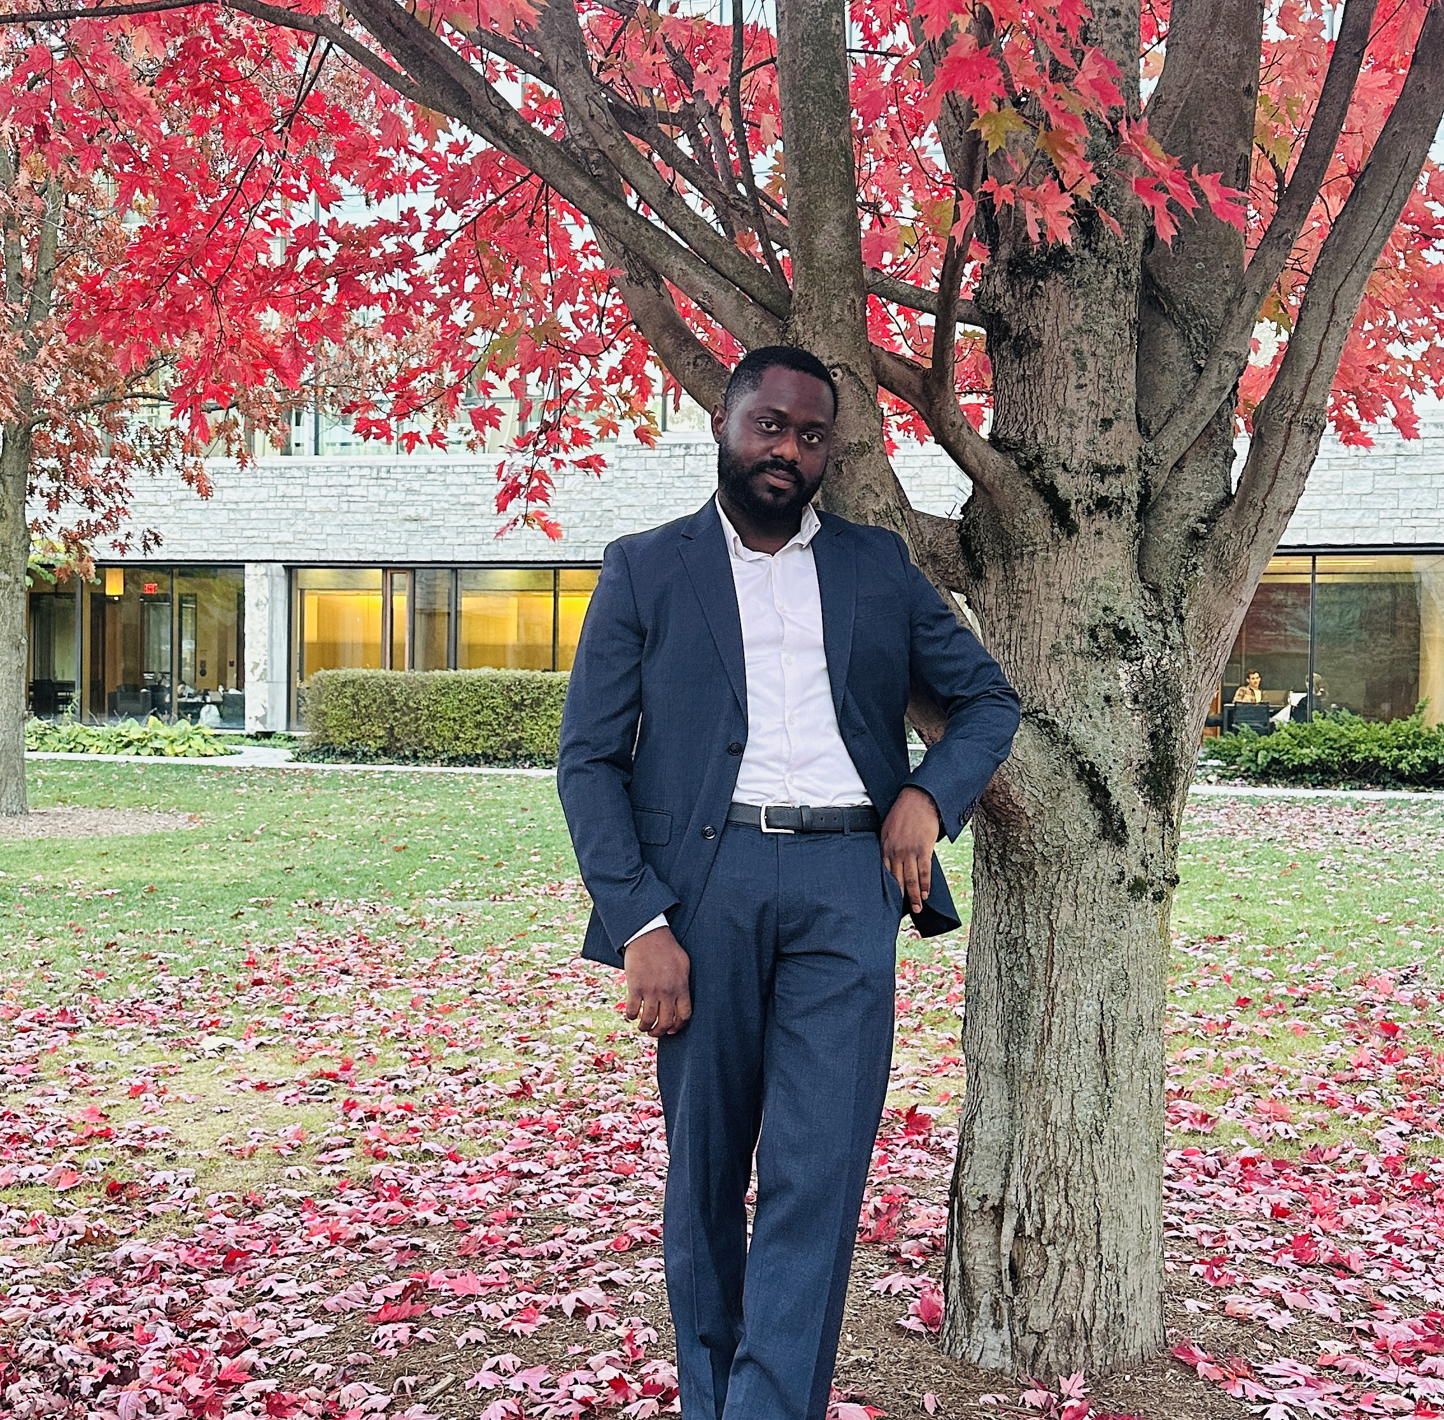
LET’S CONNECT
Daniel
Ebitunmise
Toronto, Canada
mr.tunmise@gmail.com
368-299-6773
linkedin.com/in/daniel-ebitunmise
THANK YOU FOR VIEWING MY WORK
Notes:
[Sources]
- Contact details: user-supplied portfolio materials.
- Portrait: user-provided IMG_9316.jpg, supplied 2026-09-03.
[/Sources]

